Slide 1
Ethereum, Light Wallet & Mining (CPU & GPU)

Slide 2
About
Runs on blockchain technology, similar to Bitcoin
Decentralised
Specialised for smart contracts (Computer protocols that facilitates, executes and enforces the negotiation of a contract using blockchain technology. [1]
Uses Solidity for building smart contracts [2]
Currency base unit is wei (not ether) [3]

Slide 3
Uses
Create tradable digital token
Representation of assets, virtual shares, memberships
Puzzle-based Cryptocurrencies
Crowdfunding
Auction
Shareholder voting
and others [25]

Slide 4
Database
Ethereum (and Bitcoin) uses levelDB for its database. LevelDB is a key-value database, similar to BoltDB that is used by Carbonchain.
LevelDB was used as no additional software is not required to be installed, is cross-platform and written in Go.
Due to Ethereum’s structure, it uses hashes to identify anything. LevelDB keeps keys organized “alphabetically” on disk.
[29]

Slide 5
Cryptography
All hashes in Ethereum use Keccak-256 (variant of SHA3), unless otherwise stated. Using the word “testing”:
SHA3: 7f5979fb78f082e8b1c676635db8795c4ac6faba03525fb708cb5fd68fd40c5e
Keccak-256 & Ethereum: 5f16f4c7f149ac4f9510d9cf8cf384038ad348b3bcdc01915f95de12df9d1b02 Ethereum: https://ethereum.github.io/browser-solidity/#gist=f50128d63b5188490fa2 Keccak-256: http://emn178.github.io/online-tools/keccak_256.html SHA256 (NIST standard): http://emn178.github.io/online-tools/sha3_256.html

Slide 6
Formal Terminologies
Uncles: Stale blocks on the same blockchain height
Gas: Measurement of computational effort (Also easily understood as transaction step) [5]
Radix Tree: Data structure representing a space-optimized trie (digital tree) where each node that is the only child is merged with its parent. [6]
A
b
l
m
ner
out
one
ack
mo
Abner
About
Alone
Alack
Ammo
Notes:
Radix tree: since data is stored in hex format, there can be at most 16 child nodes for each root.

Slide 7
Uncle (Ommer)
Blockchain
Same blockchain height
Parent
Child
Header of block
Hash
Orphaned blocks are duplicate blocks found by miners but were too slow in propagating into the blockchain network
Orphaned
blocks
(Uncles)
Time

Slide 8
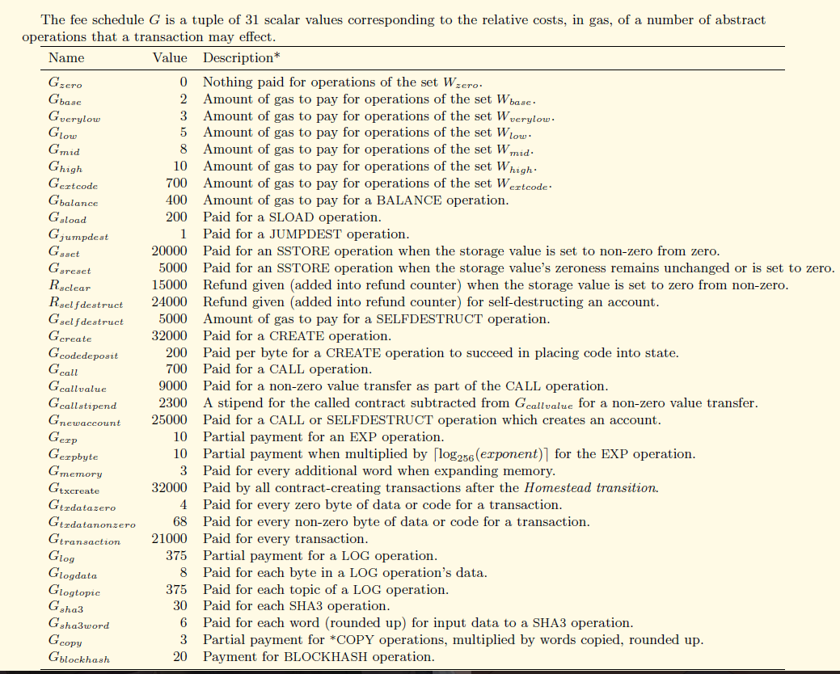
Gas
[7]

Slide 9
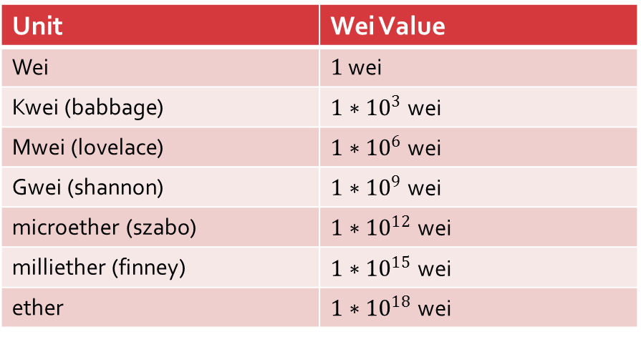

Gas
Transaction fee is calculated as $G_{amount}∗G_{price}=G_{Used} (TxFee)$
Table for converting ether to wei [3]
Only the required amount of ether is converted to wei when used to pay for gas [3]
Users can increase gas prices to incentivize miners to mine the transactions into the blockchain quickly and earlier [5]
Unit | Wei Value
Wei | $1$ wei
Kwei (babbage) | $1∗{10}^{3}$ wei
Mwei (lovelace) | $1∗{10}^{6}$ wei
Gwei (shannon) | $1∗{10}^{9}$ wei
microether (szabo) | $1∗{10}^{12}$ wei
milliether (finney) | $1∗{10}^{15}$ wei
ether | $1∗{10}^{18}$ wei

Slide 10
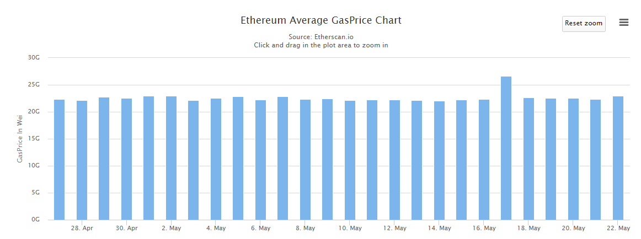
Gas
Average GasPrice Chart: https://etherscan.io/chart/gasprice

Slide 11
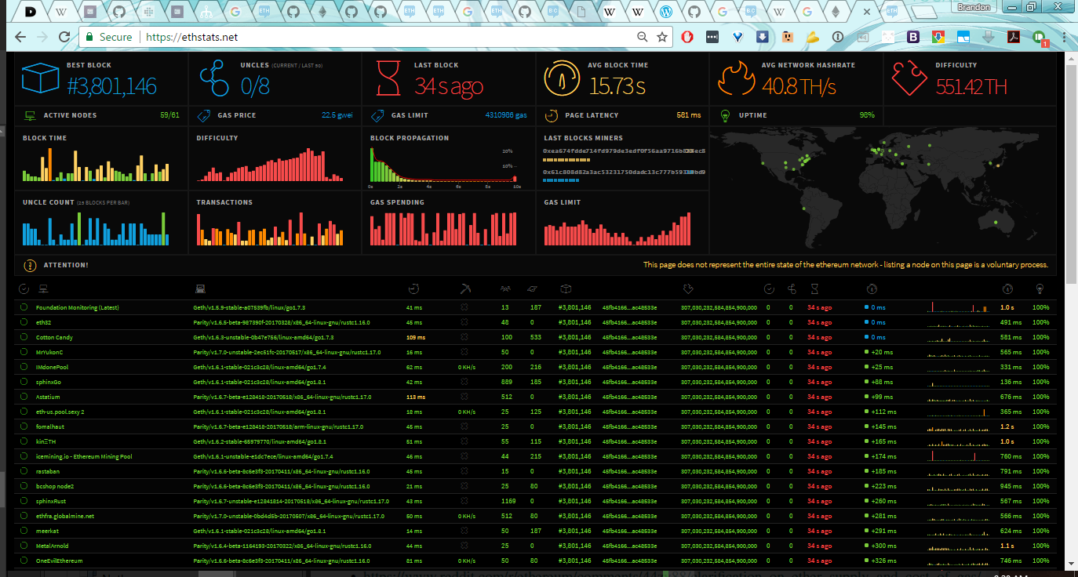
Gas
Gas limit for transactions: https://ethstats.net/
4310986 gas
Notes:
4310986

Slide 12
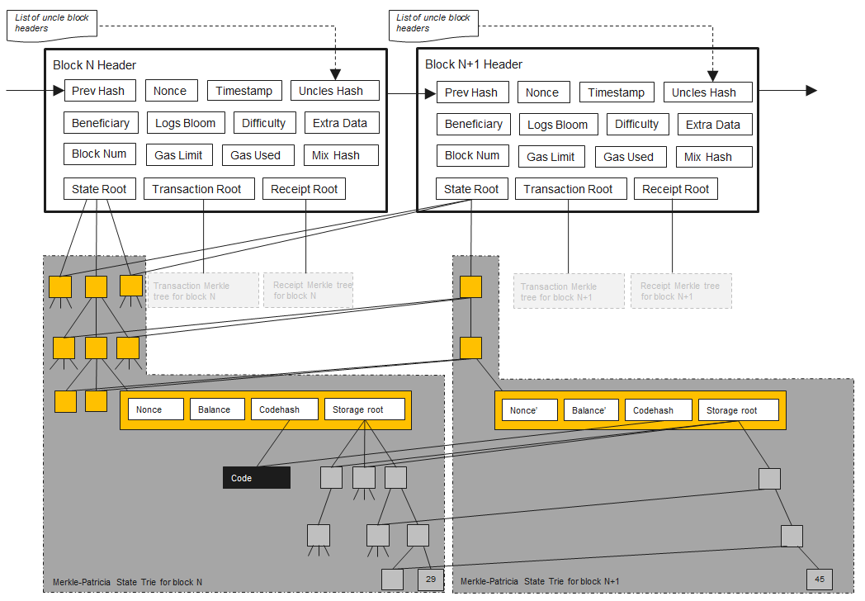
Architecture
[4]

Slide 13
Header Fields
Previous Hash: Hash of previous block header
Nonce: A 64-bit hash with mixHash that satisfies the proof of work
Timestamp: The time in UTC that the block was created
Uncles Hash: Hash of stale blocks on the same level
Beneficiary: Ethereum address of miner where the fees from the mining will go to
Logs Bloom: Indexed information of all transactions in the block
Difficulty: Difficulty in mining the block
Extra Data: Byte array containing data relevant to the block (<32 bytes)
Number: Block number in the blockchain
Gas Limit: Limit of gas that is allowed to be use per block
Gas Used: Amount of gas used for transaction in current block
[7]

Slide 14
Header Fields
Mix Hash: A 256-bit hash with nonce which proves that sufficient computation has been performed on the block
State Root: A radix tree with a 256-bit hash of the root node after all transactions are executed and finalisations applied. (Information of all accounts in the blockchain [8] )
Transactions Root: A radix tree with a 256-bit hash of the root node populated with each transaction in the block
Receipts Root: A radix tree with a 256-bit hash of the root node populated with receipts of each transaction in the block
[7]

Slide 15
Architecture

Slide 16


Architecture
Block $N$
Block $N+1$
No change of account information in $N+1$, so it is referenced to the block where the data was last changed. [8]
Notes:
State Root: Information of all accounts in the blockchain. Since the information of accounts is not changed in block N+1, it is referenced to block N where the data was changed. In this way, there will be no duplicate data in the headers and it is kept small.

Slide 17
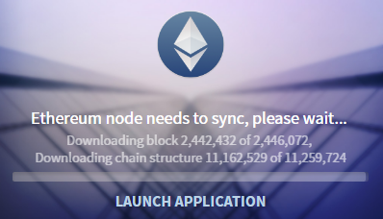
Chain Structure
Ethereum as previously mentioned uses radix trees for its transaction tree, receipts tree and state tree.
The chain structure is easily visualized when creating, modifying or deleting states to form the radix trees.
To easily illustrate the formation of chain structures in Ethereum, we pick the block number 2442432 that is during the period of attack on the blockchain between 2.42-2.46 million blocks where 19 million empty accounts were created. This attack caused the block to have a chain structure of 11259724.
[28]

Slide 18
Light Wallet
Suitable for mobile
Suitable for those on limited hardware or embedded systems
Suitable for those who do not want to (or cannot) download the full blockchain
Suitable for simple transactions (like checking balances of a wallet)
Examples of light wallets: Google Play: https://play.google.com/store/apps/details?id=eth.org.freewallet.app&hl=en Apple Store: https://itunes.apple.com/us/app/jaxx-blockchain-wallet/id1084514516?mt=8

Slide 19
Light Wallet
Light clients downloads only block headers
If required, it verifies the relevant information using Distributed Hash Table (DHT) and stores the key-value pairs in a database on the local storage.
Few to no blocks are stored on the device due to storage constraints of light clients.
Light clients make use of the Simplified Payment Verification (SPV) protocol and proof to retrieve relevant information. [9]

Slide 20


Light Wallet
Process (Loading balance of wallet 0x223874173):
Blockchain
1
SPV Client
(or light wallet)
Full node
1
Contacts full nodes
Notes:
Example: Load balance of wallet 0x223874173

Slide 21
Light Wallet
Process (Loading balance of wallet 0x223874173):
Blockchain
2
Headers
SPV Client
(or light wallet)
Full node
2
Downloads all block headers from full nodes
Notes:
Example: Load balance of wallet 0x223874173

Slide 22
Light Wallet
Blockchain Headers
Process (Loading balance of wallet 0x223874173):
SPV Client
(or light wallet)
Logs Bloom:
0x223536241
0x223536862
0x223874173
Logs Bloom:
0x223874173
0x223872381
0x228741156
3
Using bloom filters, it filters the relevant information
Notes:
https://ethereum.stackexchange.com/questions/3418/how-does-ethereum-make-use-of-bloom-filters
Example: Load balance of wallet 0x223874173

Slide 23
Light Wallet
Blockchain Headers
Process (Loading balance of wallet 0x223874173):
SPV Client
(or light wallet)
223
22
536
874
387
874
241
862
173
41
2381
1156
4
It searches the transaction receipts trie of the matching block headers
73

Slide 24
Light Wallet
Blockchain Headers
Process (Loading balance of wallet 0x223874173):
SPV Client
(or light wallet)
Tx
Tx
1d
8x
3v
96
Relevant transactions
5
RLP (Recursive Length Prefix) is checked to see if it matches the transaction
Notes:
https://github.com/ethereum/wiki/wiki/RLP

Slide 25
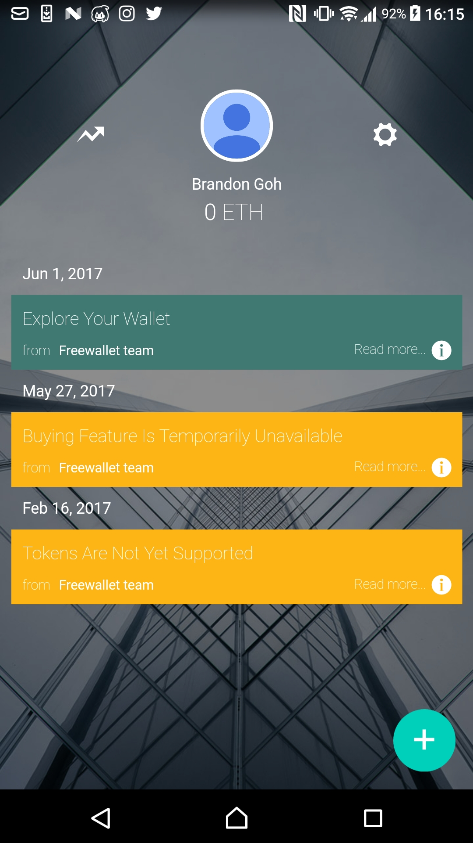
Light Wallet
Process:
SPV Client
(or light wallet)
6
SPV Client outputs the query result
Query output
Notes:
https://github.com/ethereum/wiki/wiki/RLP

Slide 26
Genesis Block
The genesis block is the first block in the blockchain, it is usually denoted as height 0
For Bitcoin, the hash of the genesis block is 0x000000000019d6689c085ae165831e934ff763ae46a2a6c172b3f1b60a8ce26f
For Ethereum (and Ethereum Classic), the hash of the genesis block is 0xd4e56740f876aef8c010b86a40d5f56745a118d0906a34e69aec8c0db1cb8fa3 *Ethereum and Ethereum Classic has the same genesis block as Ethereum is a hard fork from the original chain (at block 1920000) due to the hack of the DAO

Slide 27
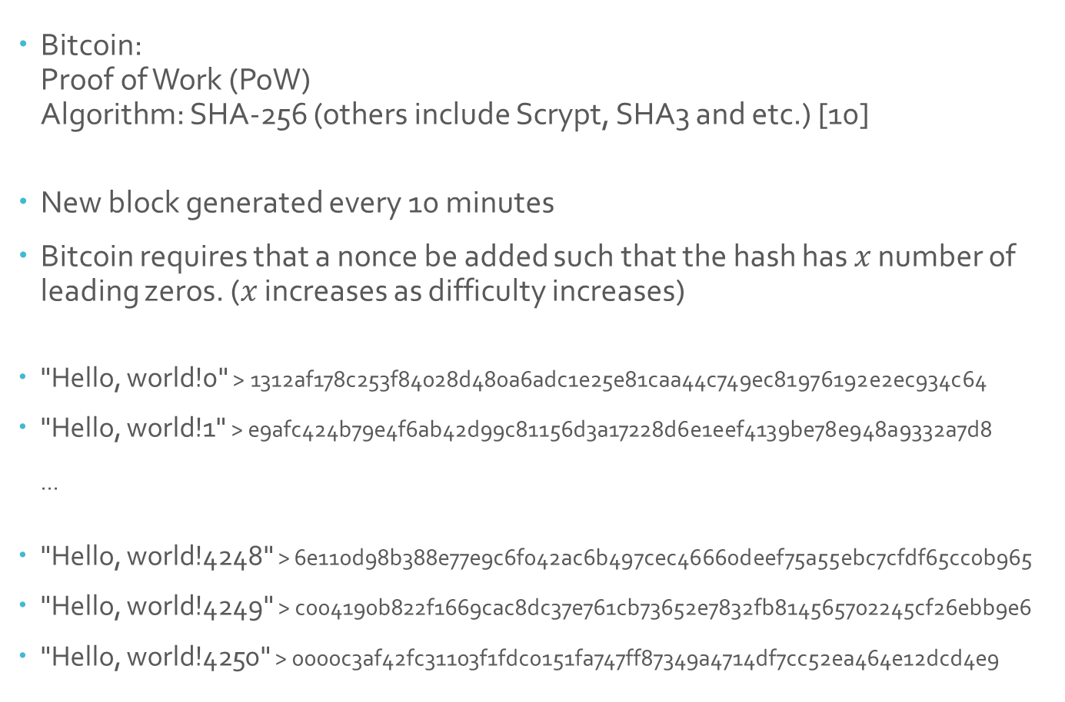
Mining
Bitcoin: Proof of Work (PoW) Algorithm: SHA-256 (others include Scrypt, SHA3 and etc.) [10]
New block generated every 10 minutes
Bitcoin requires that a nonce be added such that the hash has $x$ number of leading zeros. ($x$ increases as difficulty increases)
"Hello, world!0" > 1312af178c253f84028d480a6adc1e25e81caa44c749ec81976192e2ec934c64
"Hello, world!1" > e9afc424b79e4f6ab42d99c81156d3a17228d6e1eef4139be78e948a9332a7d8 ...
"Hello, world!4248" > 6e110d98b388e77e9c6f042ac6b497cec46660deef75a55ebc7cfdf65cc0b965
"Hello, world!4249" > c004190b822f1669cac8dc37e761cb73652e7832fb814565702245cf26ebb9e6
"Hello, world!4250" > 0000c3af42fc31103f1fdc0151fa747ff87349a4714df7cc52ea464e12dcd4e9
Nonce

Slide 28
Mining
As it is difficult to predict the nonce such that it satisfies the difficulty conditions, many rounds are needed.
This also proves that the system has done sufficient amount of work and is rewarded accordingly

Slide 29
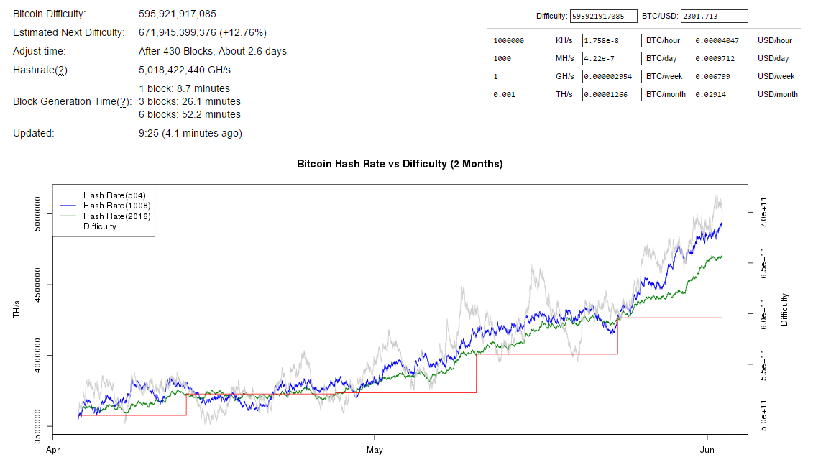
Mining
Hashrate calculator (Bitcoin): https://bitcoinwisdom.com/bitcoin/difficulty
Notes:
Open link to show real-time data

Slide 30
Mining
Hashrate calculator (Bitcoin): http://www.coinwarz.com/calculators/bitcoin-mining-calculator
As hash rates increases, number of bitcoins increases
As difficulty increases, number of bitcoins decreases

Slide 31
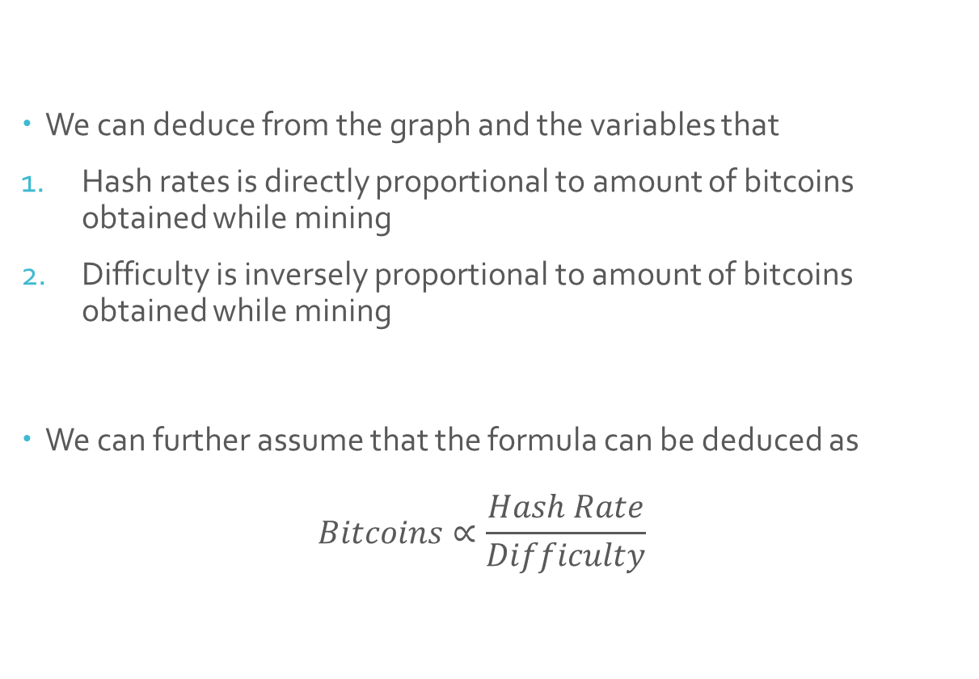
Mining
We can deduce from the graph and the variables that
Hash rates is directly proportional to amount of bitcoins obtained while mining
Difficulty is inversely proportional to amount of bitcoins obtained while mining
We can further assume that the formula can be deduced as $Bitcoins∝\frac{Hash Rate}{Difficulty}$

Slide 32
Mining
Hashrate calculator (Bitcoin): http://www.coinwarz.com/calculators/bitcoin-mining-calculator
CPU
At most 140 Mhash/s
Notes:
At most 140 Mhash/s

Slide 33
Mining
Assumptions:
Power (cost) is free
Power usage (of system) is not measured
Pool fees are negligible
No hardware costs
Notes:
At most 140 Mhash/s

Slide 34
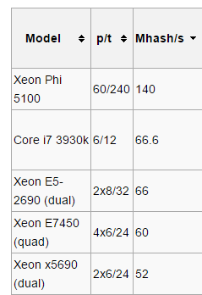
Mining
CPU mining [11]:
Intel:
Desktop
Server
class processors
*p/t: core/threads

Slide 35
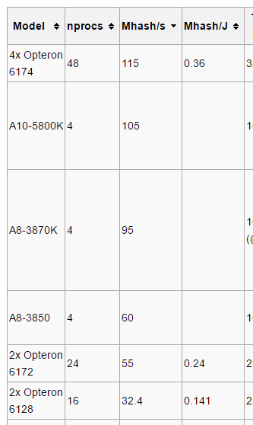
Mining
CPU/APU mining [11]:
AMD:
Desktop
Server
class processors

Slide 36
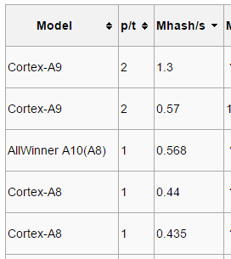
Mining
CPU mining [11]:
ARM:
*p/t: core/threads
Notes:
ARM: Advanced RISC (reduced instruction set computing) Machine

Slide 37
Mining
Hashrate calculator (Bitcoin): http://www.coinwarz.com/calculators/bitcoin-mining-calculator
GPU
At most 2.568 Ghash/s

Slide 38
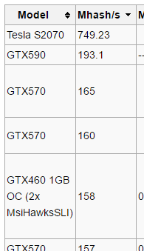
Mining
GPU mining [11]:
NVIDIA:
USD $18,995 [12]
Desktop
HPC Server
class processors
Notes:
Price source: https://forums.geforce.com/default/topic/452490/the-geforce-lounge/new-nvidia-tesla-gpus-reduce-cost-of-supercomputing-by-a-factor-of-10/
19k USD (In yr 2010), still not economical

Slide 39
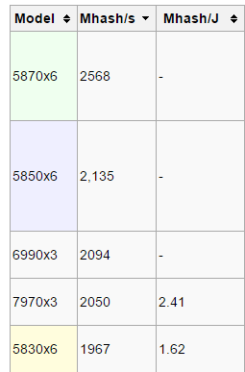
Mining
GPU mining [11]:
AMD:
Desktop
class processors
Number of graphic cards in a system

Slide 40
Mining
Hashrate calculator (Bitcoin): http://www.coinwarz.com/calculators/bitcoin-mining-calculator
FPGA
Up to 25 Ghash/s
Notes:
At most 140 Mhash/s

Slide 41
Mining
FPGA: Field Programming Gate Array
Integrated Circuit (IC) that can be specially programmed for certain uses by the user after manufacture. [13]

Slide 42
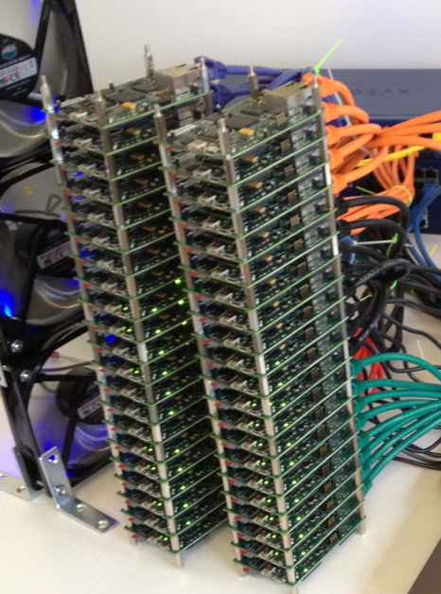
Mining
Depending on the manufacturing, FPGA can be stacked together [14]

Slide 43
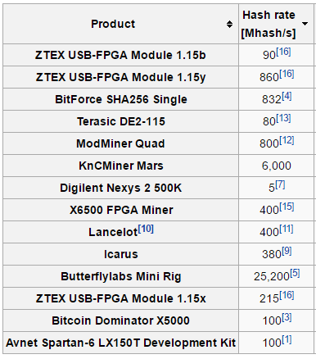
Mining
FPGA mining (per unit) [15]:
5-25200 Mhash/s

Slide 44
Mining
Hashrate calculator (Bitcoin): http://www.coinwarz.com/calculators/bitcoin-mining-calculator
ASIC
Up to 14 Thash/s

Slide 45
Mining
ASIC: Application Specific Integrated Circuit
Specially programmed for a specific task during manufacture[16] (Usually made in the form of a USB stick for bitcoin)
Notes:
http://whatis.techtarget.com/definition/ASIC-application-specific-integrated-circuit

Slide 46
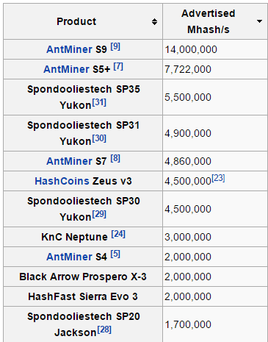
Mining
ASIC mining (per unit) [15]:
Up to 14 Thash/s, but many discontinued
Notes:
https://en.bitcoin.it/wiki/Mining_hardware_comparison
All except AntMiner S9 have been discontinued

Slide 47
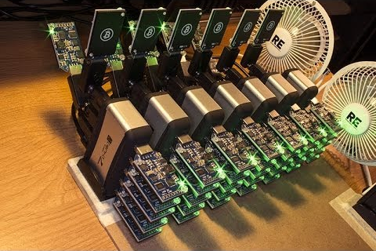
Mining
Like ASIC, it can be used together [17]:

Slide 48
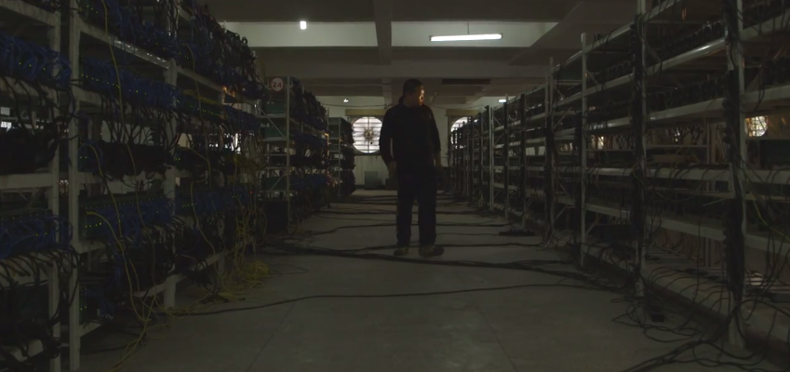
Mining
Datacenters have been created to mine bitcoins [18]

Slide 49
Mining
Advantages of ASIC/FPGA mining over CPU/GPU:
High hash rate
Specially built for bitcoin mining
Less power used per hash → Less heat
Cheaper per hash
Disadvantages:
Diminishing returns (Since difficulty will only get harder with higher hashes, the amount of cryptocurrency mined will only decrease with time)

Slide 50
Mining
We also note that mining full blocks using CPU/GPU on Bitcoin blockchain is close to impossible due to the low hash rate
Instead, miners connect to a pool to pull their hash rates together Example: https://minergate.com/ *Using a pool does not require the user to download the blockchain since the pool has already downloaded it.
Finding a block will give the pool the reward for the block (currently at 12.5 bitcoins/block) and it is divided according to the amount of hashing power that each person provides. *Rewards per block will halve for every 210000 blocks [19]
However, aggregation of miners also causes problems such as the 51% attack. (Controlling more than half of the total hashrate of the blockchain) [20]
Notes:
See what mining does for bitcoin later in controlled supply for Bitcoin

Slide 51
Mining
Ethereum: Proof of Work (PoW) Algorithm: Ethash [21]
Uses Bitcoin’s method of adding nonce
A new block is added every 12 seconds. Every block mined has a reward of 5 ether. There is an infinite supply for ether as there is no halving of block reward.
Including uncles as part of the block will also reward additional ether. [22] *Stale blocks/uncles are not rewarded when mining bitcoin

Slide 52
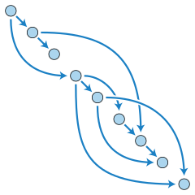
Mining
Ethereum uses memory hard Keccak algorithm to prevent ASIC miners from getting an advantage as sufficient memory is required to mine. (At least 2GB+ due to creation of a DAG (Directed Acyclic Graph) at present) DAG:
The DAG is recreated every 30000 blocks (approximately every 100 hours) and therefore memory intensive
The DAG also increases in size at about 0.73x per year to emulate Moore’s law [23]
A DAG consists of finite number of vertices and edges, with each edge directed from one vertex to another vertex such that it will never loop back to the beginning of the chain
Notes:
Source: https://ethereum.stackexchange.com/questions/1993/what-actually-is-a-dag
http://www.hashcash.org/papers/dagger.html
http://diyhpl.us/~bryan/papers2/bitcoin/meh/hashimoto.pdf
https://github.com/ethereum/wiki/wiki/Mining#so-what-is-mining-anyway
https://en.wikipedia.org/wiki/Directed_acyclic_graph

Slide 53
Mining
Considerations: Bitcoin: Computationally-intensive Ethereum: Memory-intensive
As such, an average user is able to mine the ethereum blockchain using the GPU and receive a bigger reward compared to bitcoin.

Slide 54
Mining
Hashrate calculator (Ethereum) http://www.coinwarz.com/calculators/ethereum-mining-calculator
As hash rates increases, number of ether increases
As difficulty increases, number of ether decreases

Slide 55
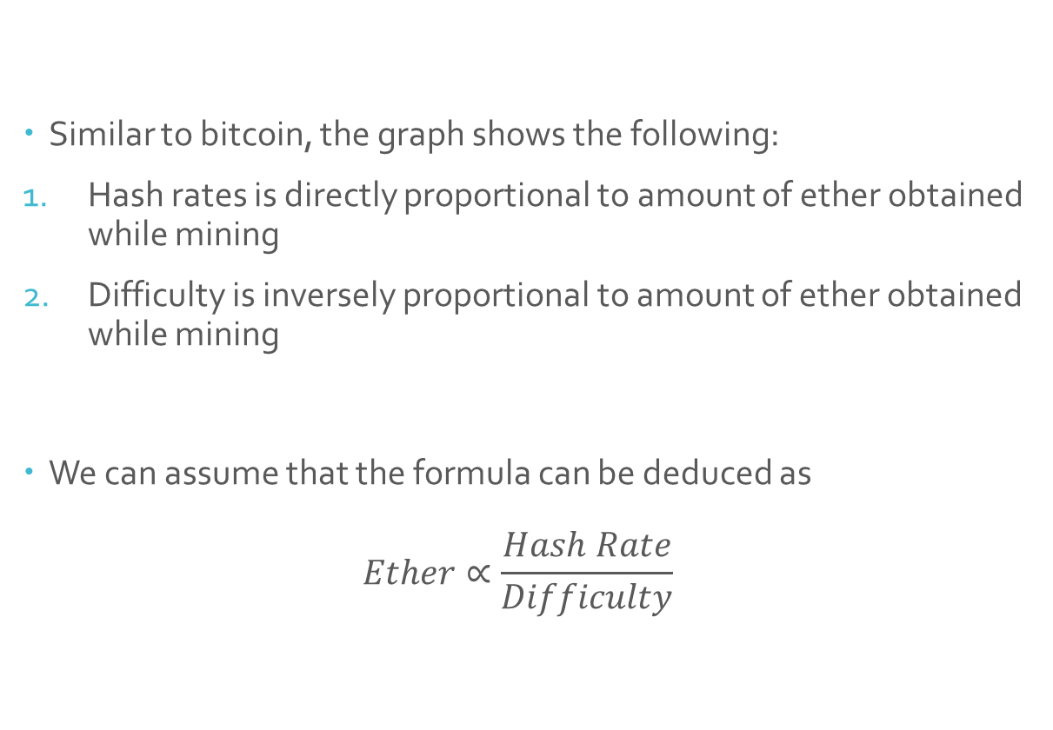
Mining
Similar to bitcoin, the graph shows the following:
Hash rates is directly proportional to amount of ether obtained while mining
Difficulty is inversely proportional to amount of ether obtained while mining
We can assume that the formula can be deduced as $Ether∝\frac{Hash Rate}{Difficulty}$

Slide 56
Mining
Assumptions:
Power (cost) is free
Power usage (of system) is not measured
Pool fees are negligible
No hardware costs
Notes:
At most 140 Mhash/s

Slide 57
Mining
We ignore CPU mining as hashrates are too small as seen from Bitcoin mining statistics (and similarly for Ethereum)

Slide 58
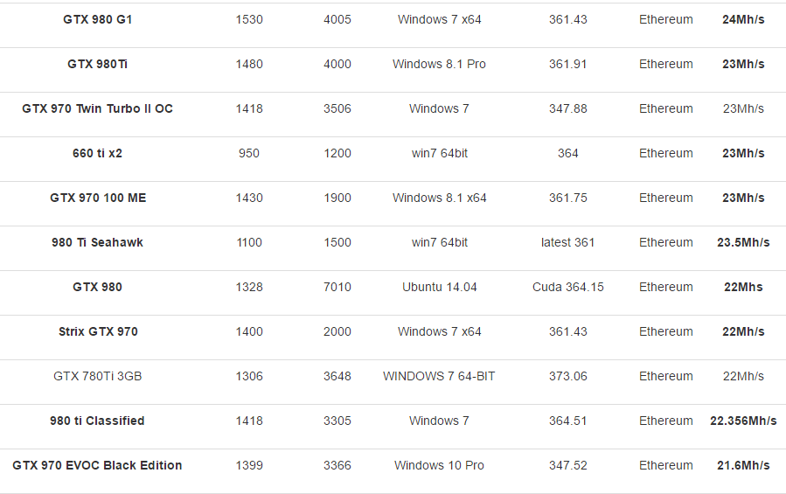
Mining
GPU mining:
NVIDIA:
Desktop
class GPU
~20Mhash/s

Slide 59
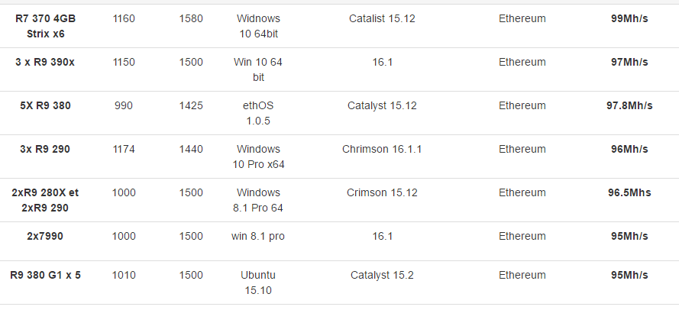
Mining
GPU mining:
AMD:
Desktop
class GPU
~100Mhash/s

Slide 60
Mining
AMD cards in general are faster than their NVIDIA counterparts.
This is due to AMD cards having more (but slower) processors compared to NVIDIA cards having less (but faster) processors.
Results in NVIDIA cards reaching a performance ceiling faster and remaining stagnant. [24]

Slide 61
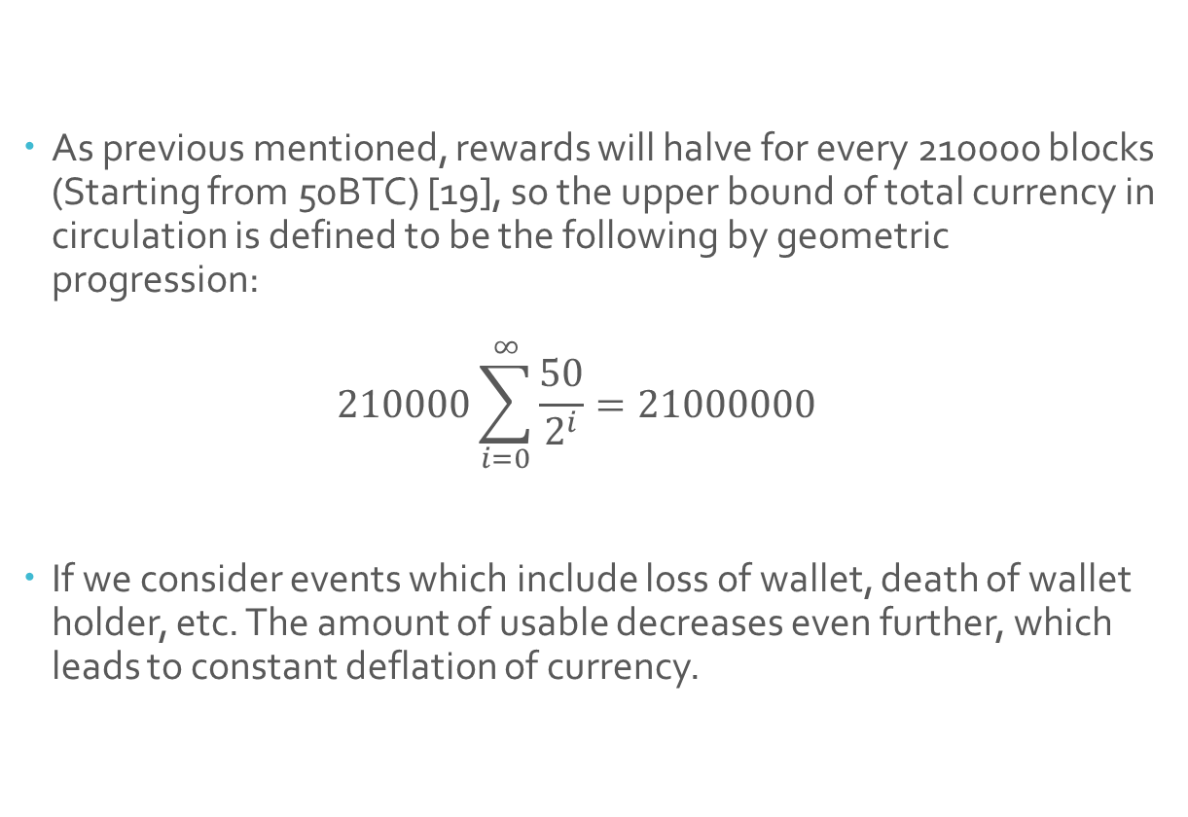
Currency (Bitcoin)
As previous mentioned, rewards will halve for every 210000 blocks (Starting from 50BTC) [19], so the upper bound of total currency in circulation is defined to be the following by geometric progression: $210000\sum_{i=0}^{∞}{\frac{50}{2^{i}}}=21000000$
If we consider events which include loss of wallet, death of wallet holder, etc. The amount of usable decreases even further, which leads to constant deflation of currency.
Notes:
In times of deflation, the purchasing power of currency and wages are higher than they otherwise would have been. i.e. With the same amount of money, more things can be bought or obtained.
https://en.bitcoin.it/wiki/Controlled_supply

Slide 62
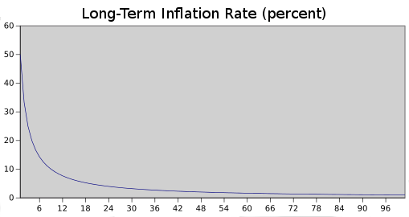
Currency (Ethereum)
Ethereum has a constant block reward of 5 ether, with additional reward for finding uncles. This would technically lead to an infinite supply of ether in circulation.
Events which include loss of wallet, death of wallet holder, etc. will be expected to stabilize with the supply being generated (0% net gain/loss of currency).
Hence, it would be reasonable to assume that deflation will slow down or be stable in the long run, compared to Bitcoin.
Notes:
In times of deflation, the purchasing power of currency and wages are higher than they otherwise would have been. i.e. With the same amount of money, more things can be bought or obtained. [26]

Slide 63
References
http://www.blockchaintechnologies.com/blockchain-smart-contracts#smart-contract-definition
https://solidity.readthedocs.io/en/develop/
http://www.ethdocs.org/en/latest/
https://ethereum.stackexchange.com/questions/268/ethereum-block-architecture
https://ethereum.stackexchange.com/questions/3/what-is-gas-and-transaction-fee-in-ethereum
https://en.wikipedia.org/wiki/Radix_tree
https://github.com/ethereum/yellowpaper
https://ethereum.stackexchange.com/questions/15288/ethereum-merkle-tree-explanation
https://github.com/ethereum/wiki/wiki/Light-client-protocol
https://en.bitcoin.it/wiki/Proof_of_work
https://en.bitcoin.it/wiki/Non-specialized_hardware_comparison
https://forums.geforce.com/default/topic/452490/the-geforce-lounge/new-nvidia-tesla-gpus-reduce-cost-of-supercomputing-by-a-factor-of-10/
http://whatis.techtarget.com/definition/field-programmable-gate-array-FPGA
https://www.aliexpress.com/store/product/1PCS-400MH-s-FPGA-Bitcoin-Miner-X-1Pcs-Ship-Now/105890_1190143554.html
https://en.bitcoin.it/wiki/Mining_hardware_comparison
http://whatis.techtarget.com/definition/ASIC-application-specific-integrated-circuit
https://i.ytimg.com/vi/5QFceDeP6mQ/hqdefault.jpg
https://motherboard.vice.com/en_us/article/chinas-biggest-secret-bitcoin-mine
https://en.bitcoin.it/wiki/Controlled_supply
https://arstechnica.com/security/2014/06/after-reaching-51-network-power-bitcoin-mining-pool-says-trust-us/
https://github.com/ethereum/wiki/wiki/Ethash
https://blog.ethereum.org/2014/07/11/toward-a-12-second-block-time/
https://github.com/ethereum/wiki/wiki/Ethash-Design-Rationale
https://bitcoin.stackexchange.com/questions/9854/why-do-amds-gpus-mine-faster-than-nvidias/9855
https://dapps.ethercasts.com/
http://www.investopedia.com/terms/d/deflation.asp
https://github.com/ethereum/wiki/wiki/White-Paper
https://ethereum.stackexchange.com/questions/9313/how-do-i-find-out-how-big-the-chain-structure-is-for-a-particular-block
https://ethereum.stackexchange.com/questions/824/which-databases-do-the-ethereum-clients-use-and-why

